Slide 1
Biology of B-Cells
Phd. dr. Rana A. Fayez
Microbiology & Immunity

Slide 2
Where are B cells located?
B cells exist in different places depending on their stage of development.
In fetuses, the liver makes B cells. Once you’re born, B cells develop in the spongy tissue inside your bone called bone marrow.
They start as hematopoietic stem cells and eventually become B cells during a process called hematopoiesis.
Once they’re fully mature, your B cells travel to important parts of your lymphatic system, including your spleen and lymph nodes.

Slide 3
Function
Why are B cells important?
B cells are an important part of your adaptive immune system.
Your immune system includes your innate immune system and your adaptive immune system.
While your innate immune system is your first defense against any threat, your adaptive immune system is specialized to recognize and fight particular types of threats (a particular virus, bacteria, etc.).
B cells produce antibodies that destroy antigens or the pathogen associated with a particular antigen.

Slide 4
ANTIGEN RECOGNITION BY B CELLS
the BCR (surface membrane immunoglobulin) interacts with a much larger area of an intact antigenic epitope that generally has conformational or planar structure.
Consequently, the B cell has no requirement for antigen processing and may directly recognize antigen.
Although antigen may sometimes be associated with the surface of an APC, the epitopes remain intact and are bound by the BCR without prior processing

Slide 5
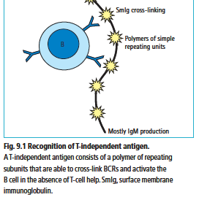
B-cell antigen recognition may be thymus independent or thymus dependent.
Thymus independent (T-independent) recognition is a relatively uncommon event and is restricted to antigens composed of polymers of simple repeating structural units.

Slide 6
ACTIVATION OF THE B LYMPHOCYTE 1
The activation of a naïve B cell is not dissimilar to the process of T-cell activation
The B cell requires three specific signals in order to become fully activated
• Signal 1 for B-cell activation is the recognition of antigenic epitope by the surface membrane BCR. Signal transduction for the BCR is undertaken by a complex of CD79a and CD79b
• Signal 2 comprises intermolecular interactions between surface molecules on that B cell . One such interaction results from the B cell internalizing antigen and presenting peptide fragments associated with MHC class II molecules.
• Signal 3 for B-cell activation takes the form of a co-stimulatory cytokine released by the Th cell that binds to a cytokine receptor on the surface of the B cell. A range of cytokines act in this fashion (depending on the nature of the antigen, the subset of Th cell and the type of immune
response required) including IL-4, IL-5, IL-13, TGF-β and IFN-γ.

Slide 7
ACTIVATION OF THE B LYMPHOCYTE 2

Slide 8
1- Immature bone marrow B cells undergo a process similar to the negative selection of developing intra-thymic T cells.
Alternatively, the B cell may undergo further
gene rearrangements within the light chain and express a new BCR.
If this new receptor is not self-reactive, the cell will be deleted
but if not, the cell will be exported for further maturation in the periphery.
This process is known as receptor editing.

Slide 9
2. B-Cell Maturation Overview of B-cell development
. During the antigen- independent maturation phase, immunocompetent B cells expressing membrane IgM and IgD are generated in the bone marrow.
Only about 10% of the potential B cells reach maturity and exit the bone marrow.
Naive B cells in the periphery die within a few days unless they encounter soluble protein antigen and activated TH cells. Once activated, B cells proliferate within secondary lymphoid organs. Those bearing high-affinity differentiate into plasma cells and memory B cells, which may express different isotypes because of class switching.

Slide 10
a) Progenitor B Cells Proliferate in Bone Marrow
Bone-marrow stromal cells are required for maturation of progenitor B cells into precursor B cells.
stem cell factor (SCF)
VCAM-1 :Vascular cell adhesion molecule-
Progenitor B cell (pro-B cell)
precursor B cells (pre-B cells)

Slide 11
b) Ig-Gene Rearrangement Produces Immature B Cells
Sequence of events and characteristics of the stages in B-cell maturation in the bone marrow.

Slide 12
c) The Pre–B-Cell Receptor Is Essential for B-Cell Development
immunoglobulin and surrogate light chain at different stages of B-cell differentiation in the bone marrow.

Slide 13
d) Self-Reactive B Cells Are Selected in Bone Marrow
Experimental evidence for negative selection (clonal deletion) of self-reactive B cells during maturation in the bone marrow

Slide 14
3.B-Cell Activation and Proliferation
After export of B cells from the bone marrow, activation, proliferation, and differentiation occur in the periphery and require antigen.
Antigen-driven activation and clonal selection of naive B cells leads to generation of plasma cells and memory B cells.
In the absence of antigen-induced activation, naive B cells in the periphery have a short life span, dying within a few weeks by apoptosis.

Slide 15
a) Thymus-Dependent and Thymus- Independent Antigen Have Different Requirements for Response
Depending on the nature of the antigen, B-cell activation proceeds by two different routes, one dependent upon TH cells, the other not.
The B-cell response to thymus-dependent (TD) antigens requires direct contact with TH cells, not simply exposure to TH-derived cytokines.
Antigens that can activate B cells in the absence of this kind of direct participation by TH cells are known as thymus-independent (TI) antigens.
TI antigens are divided into types 1 and 2, and they activate B cells by different mechanisms.
Some bacterial cell-wall components, includinglipopolysaccharide (LPS), function as type 1 thymus-independent (TI-1) antigens.
Type 2 thymus-independent (TI-2) antigens are highly repetitious molecules such as polymeric proteins (e.g., bacterial flagellin) or bacterial cell-wall polysaccharides with repeating polysaccharide units.

Slide 16
b) Two Types of Signals Drive B Cells into and Through the Cell Cycle.
An effective signal for B-cell activation involves two distinct signals induced by membrane events.
c) Transduction of Activating Signals Involves Ig-/Ig- Heterodimers
Some of the many signal-transduction pathways activated by the BCR.
d) The B-Cell–Coreceptor Complex Can Enhance B-Cell Responses
The B-cell coreceptor is a complex of three cell membrane molecules:
in Most B-Cell Responses
e) TH Cells Play Essential Roles in Most B-Cell Responses Sequence of events in B-cell activation by a thymus-dependent antigen

Slide 17
B1 AND B2 LYMPHOCYTES
B cells that arise from bone marrow stem cell precursors and play a major role in the adaptive immune response by producing antigen-specific antibody, primarily of the IgG class.
These classical B lymphocytes (known as B2 cells) are in fact just one of two B-cell subsets.
B1 lymphocytes are thought to arise from stem cell precursors in the fetal liver or abdominal omentum, and are produced only in early life.

Slide 18
MEMORY B LYMPHOCYTES
The phenomenon of B-cell memory is readily
The development of this response is monitored by daily blood sampling and testing for the titre of antigen-specific antibody within the serum.
For the first few days of the experiment, no serum antibody will be detectable, but
after 5–7 days, low-titred IgM antibody will appear.
Over the following few days, as the immunoglobulin
class switch proceeds, this will be joined by detectable
IgG antibody that gradually becomes the dominant
class of immunoglobulin. This humoral response will
peak at around 2–3 weeks after primary exposure and
the concentration of serum antibody will gradually
decline, as most immunoglobulins have a half-life of
around 10–14 days.

Slide 19
B cells protect you from infection by making proteins called antibodies. B cells are a type of white blood cell called lymphocytes. When your immune system detects antigens — markers that indicate a threat like a bacteria or virus has entered your body — your B cells produce antibodies to fight the invader.

Slide 20
DEVELOPMENT AND MATURATION OF B LYMPHOCYTES
As for all haemopoietic and immune cells,
B lymphocytes derive from bone marrow stem cells.
B-cell maturation is not as well as intra-thymic development of T cells. Some stages of maturation likely occur within the bone marrow, but in
most domestic animal species the final stages of B-cell maturation are thought to occur in extra-medullary locations e.g in avians, the bursa of Fabricius .

Slide 21
The earliest form of B cell recognized
(the pre-B cell) is a precursor that produces the μ heavy chain within the cytoplasm.
In the next stage of development,
complete IgM monomers are synthesized and the immature B cell displays these on its surface membrane.
The final step in development is the
co-expression of surface membrane IgM and IgD

Slide 22
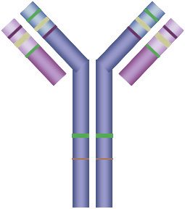
Variable region of heavy chain
Antigen binding site
Light chain
Variable region of
light chain
constant region of
light chain
Heavy chain
Constant region of heavy chain

Slide 24
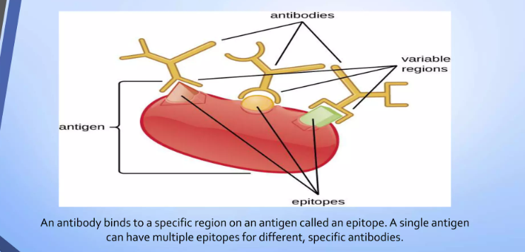

Slide 27
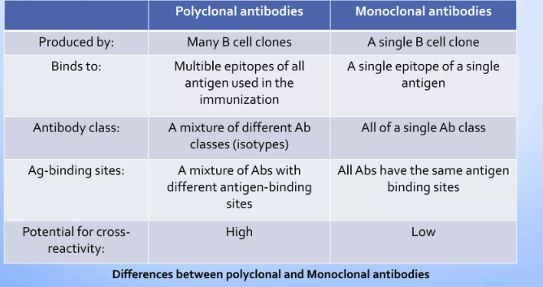

Slide 28
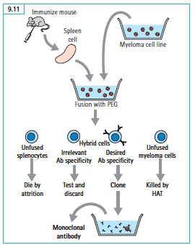

Slide 31
What are the different types of B cells?
There are two main types of B cells:
plasma cells and memory cells. Both types help protect you from infection and disease.
Plasma cells: Plasma cells release antibodies in response to antigens. Once a B cell becomes a mature plasma cell, it can release up to 2,000 antibodies per second. Plasma cells are also called plasmacytes or effector cells. They have a shorter lifespan than memory cells.
Memory cells: Memory cells remember particular antigens so, if they appear in your body in the future, your immune system can mount a defense quickly. While plasma cells fight bodily invaders by producing antibodies, memory cells help your immune system fight in the future. For example, most vaccines work because they expose your immune system to antigens that your memory cells remember. If an invader appears, your body can mount an attack quickly.

Slide 32
What are the common conditions and disorders associated with B cells?
Abnormal B cells can cause autoimmune diseases and various types of cancers.
Autoimmune diseases Sometimes, B cells make antibodies in response to antigens associated with your body’s healthy cells. When this happens, the antibodies attack your healthy cells like a dangerous pathogen. This is what happens with autoimmune diseases, including: Lupus. Multiple sclerosis. Rheumatoid arthritis. Type 1 diabetes.

Slide 33
Cancers
Several cancers are associated with abnormal B cell development, including: .Acute lymphocytic leukemia
. Chronic lymphocytic leukemia
. Hodgkin lymphoma
. Non-Hodgkin lymphoma
. B-cell lymphoma.

